Slide 1
GEOG-G489/589 Python Programming
Instructor: Natasha MacBean
Extra tips for avoiding loops or writing more efficient and/or faster code

Slide 2
Why is NumPy so useful for faster calculations on arrays of data?
NumPy vectorizes your calculations
Uses data of known type and size
Underlying loops are done using compiled C code → much faster because type checking and function calling take up a lot of time (“bookkeeping”)
NumPy also uses broadcasting to extend the ability of vectorized calculations by ”stretching” (broadcasting) arrays of different sizes so the calculations can be performed.

Slide 3
NumPy ufuncs
https://docs.scipy.org/doc/numpy/reference/ufuncs.html#
Great notes on these in Jake VanderPlas book (see syllabus): https://jakevdp.github.io/PythonDataScienceHandbook/02.03-computation-on-arrays-ufuncs.html
Things like np.sum(), np.mean(): https://docs.scipy.org/doc/numpy/reference/ufuncs.html#available-ufuncs
Can do across whole array or specific axis/axes with axis keyword
Use functions like np.newaxis to create arrays with matching dimensions (if broadcasting rules don’t apply, see here for more info: https://jakevdp.github.io/PythonDataScienceHandbook/02.05-computation-on-arrays-broadcasting.html

Slide 4
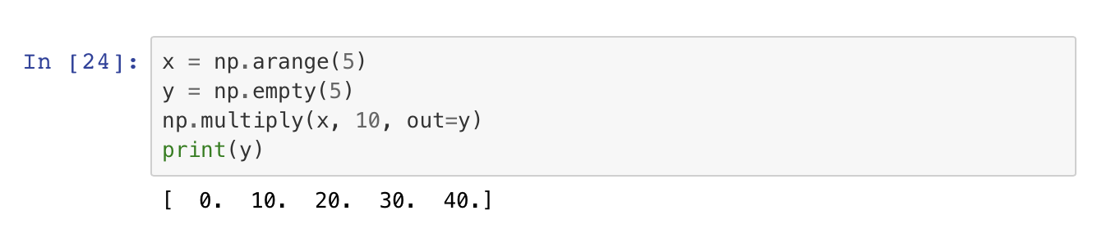
Optional keyword arguments for ufuncs
Advanced features: https://docs.scipy.org/doc/numpy/reference/ufuncs.html#overriding-ufunc-behavior

Slide 5
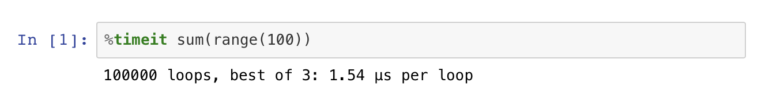
How can you check the speed of your code?
Timing and profile tools are explained really nicely here: https://jakevdp.github.io/PythonDataScienceHandbook/01.07-timing-and-profiling.html
E.g. %timeit:

Slide 6
What can you do to avoid loops if you want to speed up your code?
Check to see if there are other Python libraries that have “vectorized” the analysis you want to perform so you can perform the analysis on an entire array.
Check to see if you can use NumPy ufuncs to perform your analysis → e.g. linear regression can be solved via a matrix formulation (e.g. https://newonlinecourses.science.psu.edu/stat462/node/132/), therefore, can be done with NumPy arrays. (Note: this may or may not be more efficient depending on the size of your data).
Check to see if you can transform your data into NumPy arrays (effectively vectorizing your calculations).
Remember to use nan equivalent of ufuncs if you have missing data (with missing data replaced with np.nan).
Check out scipy special functions, which also follow vectorization and broadcasting rules: https://docs.scipy.org/doc/scipy/reference/special.html

Slide 7
What can you do to avoid loops if you want to speed up your code?
Think about what you can leave out: in the example in the last in-class exercise, we only need to loop over the land points. We can use a land/sea mask extract all the land points into one array, loop over that to perform the calculations, and then map that array back to a 2d array.
Parallelize your code using python libraries such as dask: https://docs.dask.org/en/latest/.
Pandas apply method avoids using loops – but I’m not sure how much faster it would be (https://pandas.pydata.org/pandas-docs/stable/reference/api/pandas.DataFrame.apply.html). Put all your spatial lat and lon grid cells as columns in a dataframe (index = timestep in this case) and it would loop over them.

Slide 8
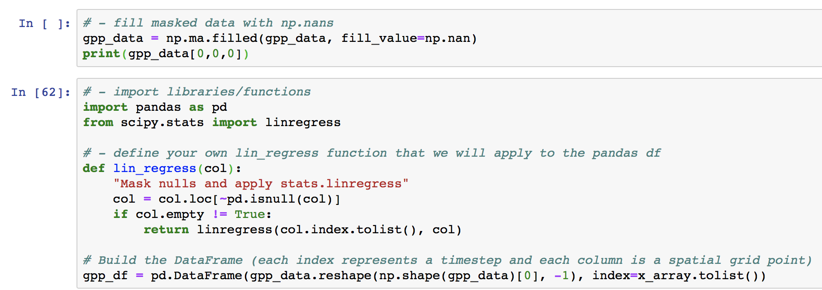
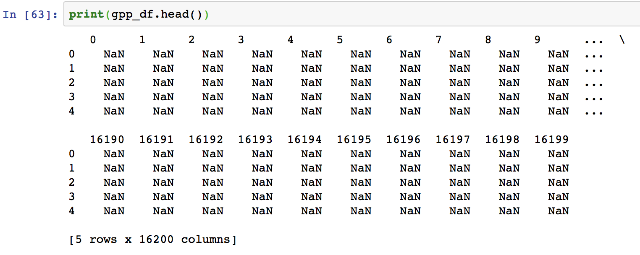
Pandas apply()

Slide 9
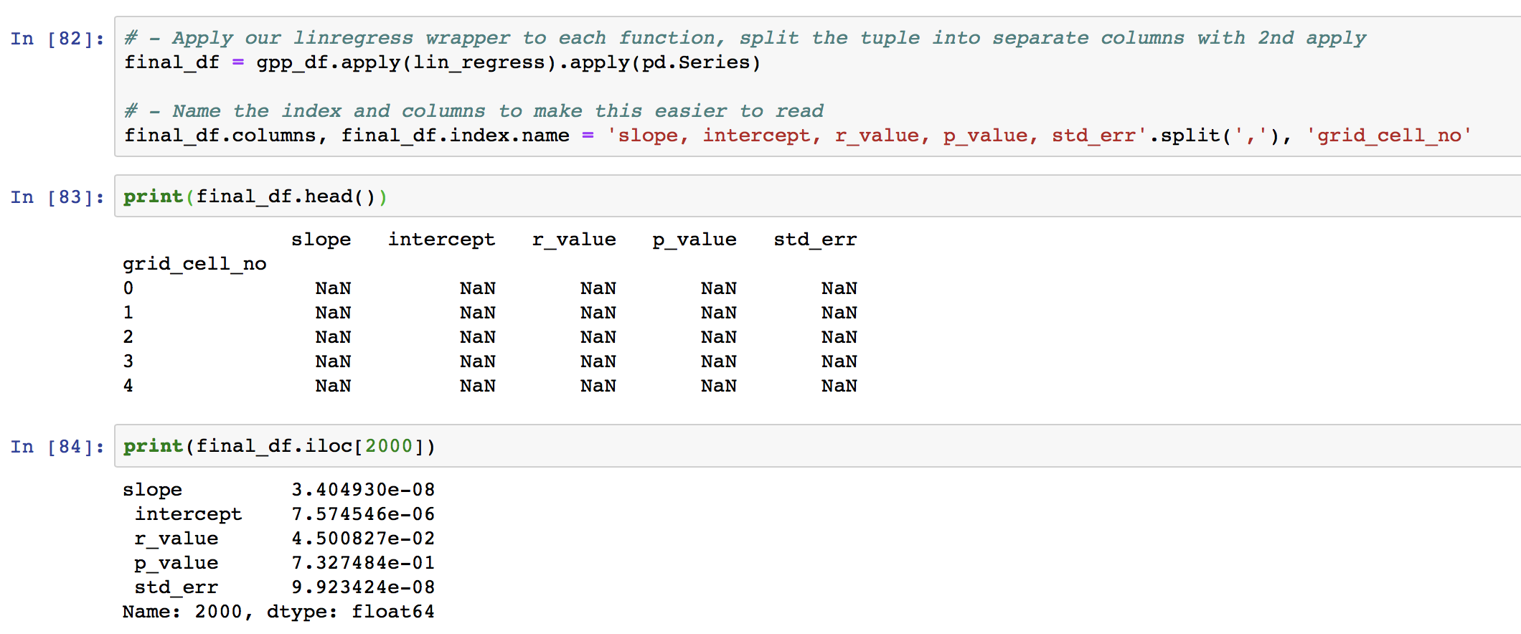
Pandas apply()

Slide 10
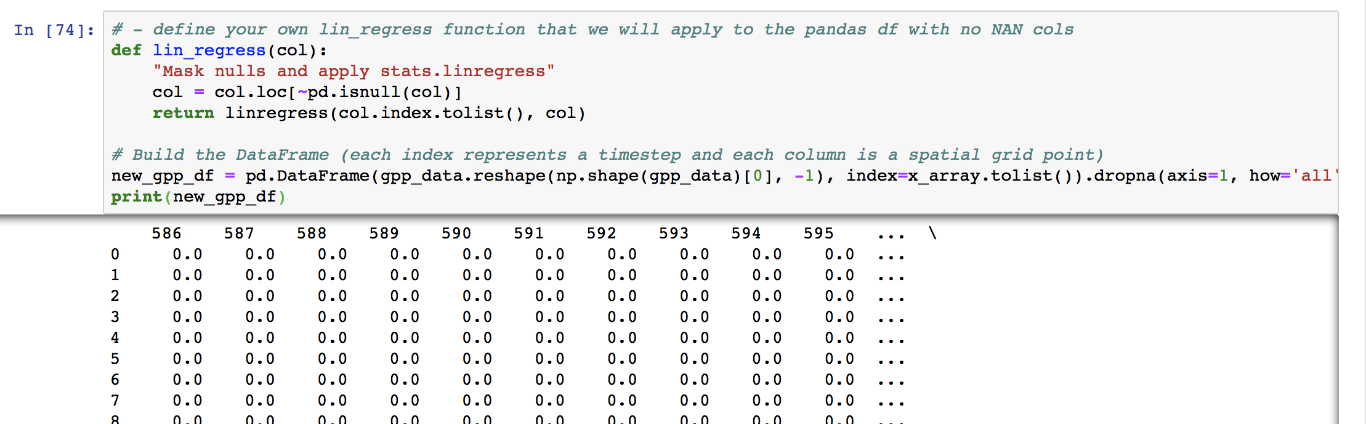
Pandas apply() → or remove all cols that contain all NaNs before you do calculation

Slide 11
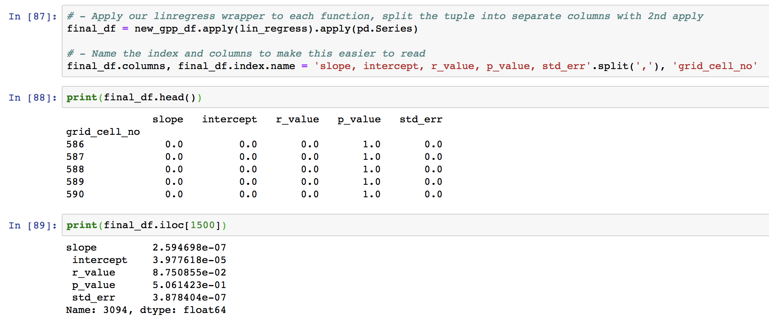
Pandas apply() → or remove all cols that contain all NaNs before you do calculation

Slide 12
One final note: Xarray python package
Combines the functionality of NumPy mutli-dimensional vectorized array functionality and pandas labelling/functions into one package: http://xarray.pydata.org/en/stable/why-xarray.html

